Slide 1
6T Configurable Memory (BCAM/TCAM/SRAM) Cell
Yixuan Huang, Hoang Yen Tran
S. Jeloka, N. B. Akesh, D. Sylvester and D. Blaauw, "A 28 nm Configurable Memory (TCAM/BCAM/SRAM) Using Push-Rule 6T Bit Cell Enabling Logic-in-Memory," in IEEE Journal of Solid-State Circuits, vol. 51, no. 4, pp. 1009-1021, April 2016, doi: 10.1109/JSSC.2016.2515510.

Slide 2
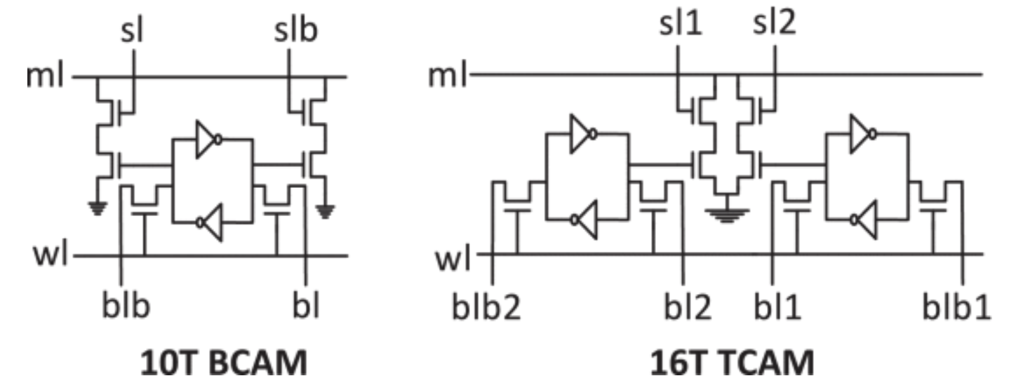
Conventional BCAM/TCAM Cell
Adapted from Jeloka et al., IEEE JSSC, 2016
Notes:
Schematic + waveforms for each

Slide 3
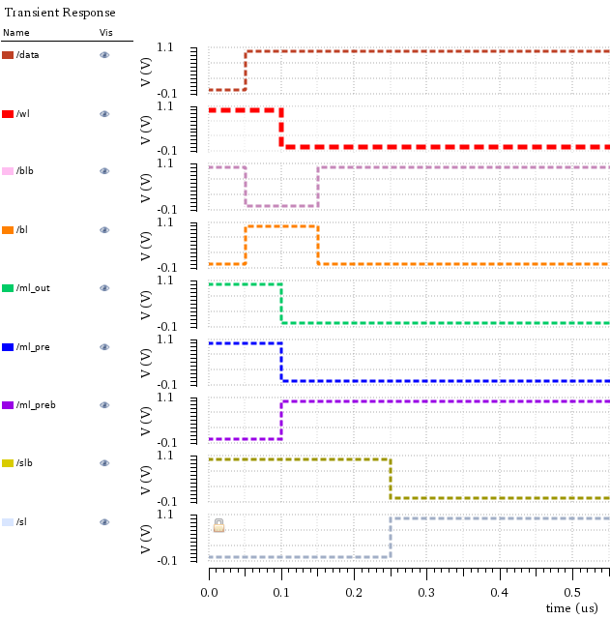
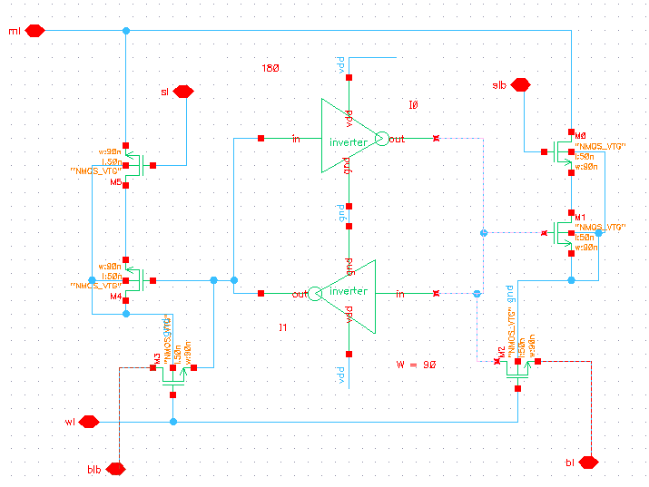
Conventional 10T BCAM
write
Search: mismatch
no write

Slide 4
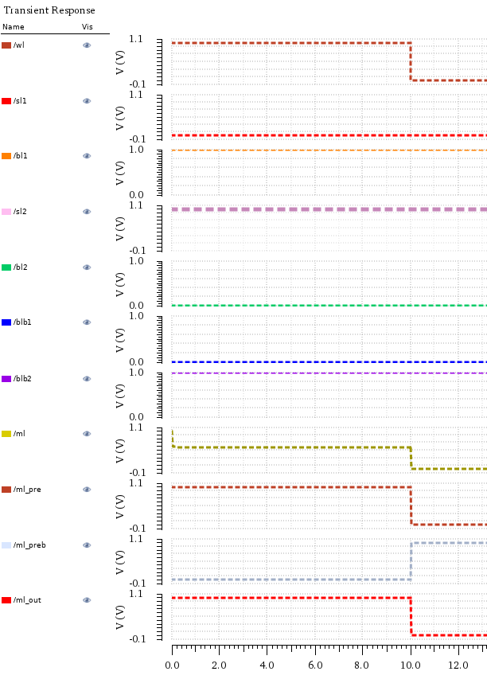
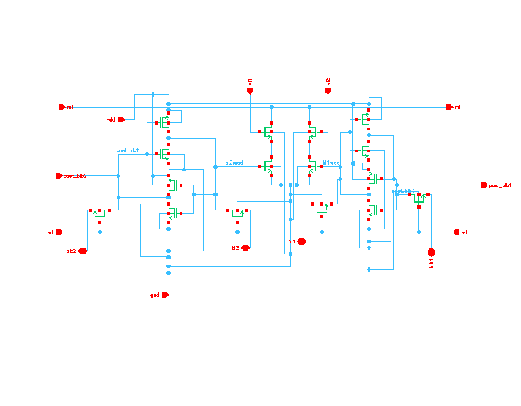
Conventional 16T schematics

Slide 5
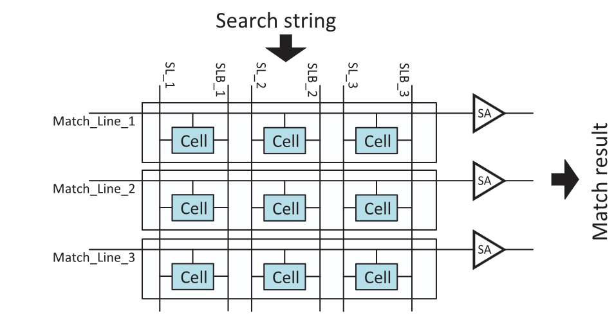
Motivation
Conventional CAM search
Traditional cell has high transistor count
-> Smaller area and lower power without much performance degradation
Adapted from Jeloka et al., IEEE JSSC, 2016
Notes:
Block diagram from cadence

Slide 6
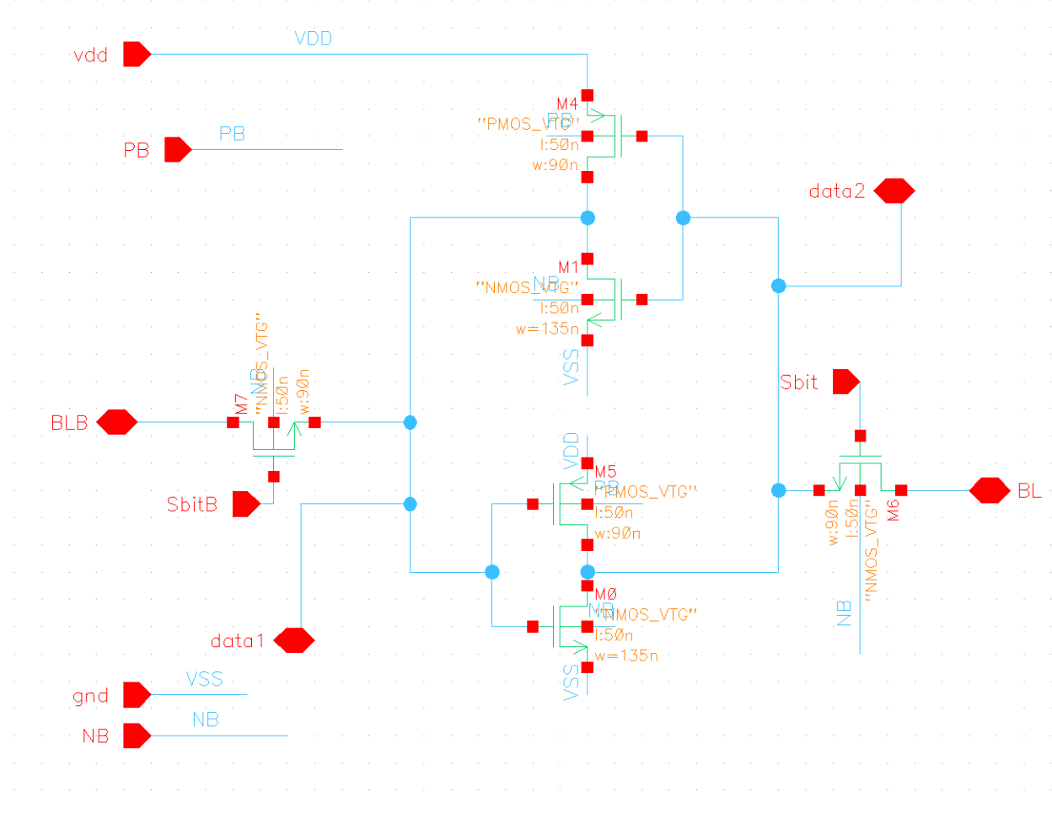
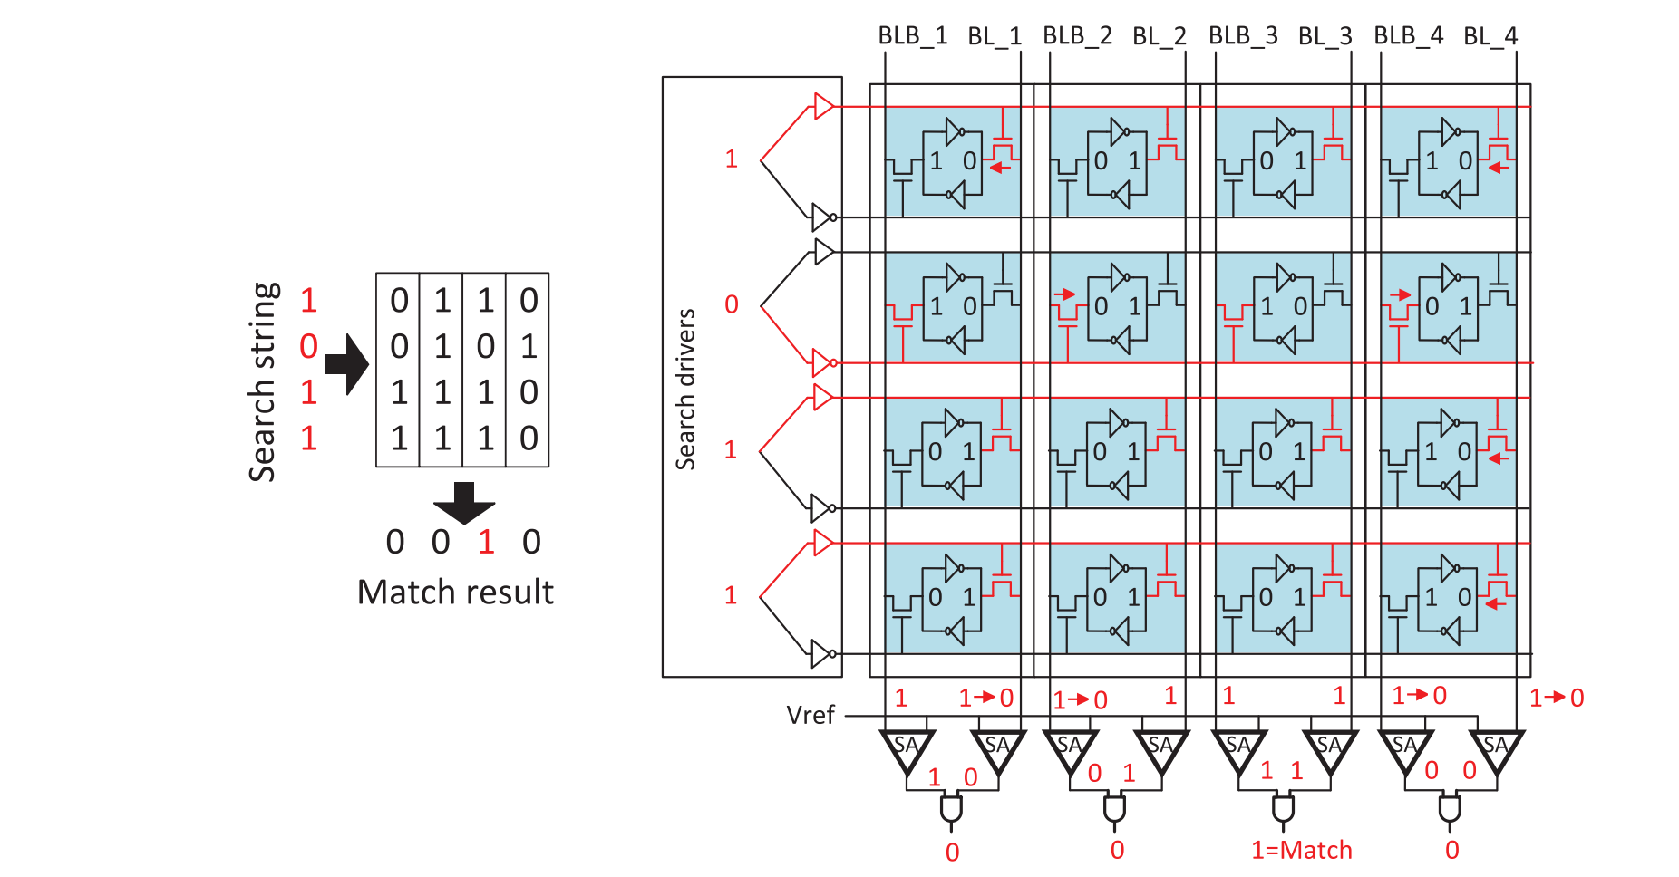
Proposed Memory Cell
Adapted from Jeloka et al., IEEE JSSC, 2016
Notes:
Our schematics

Slide 7
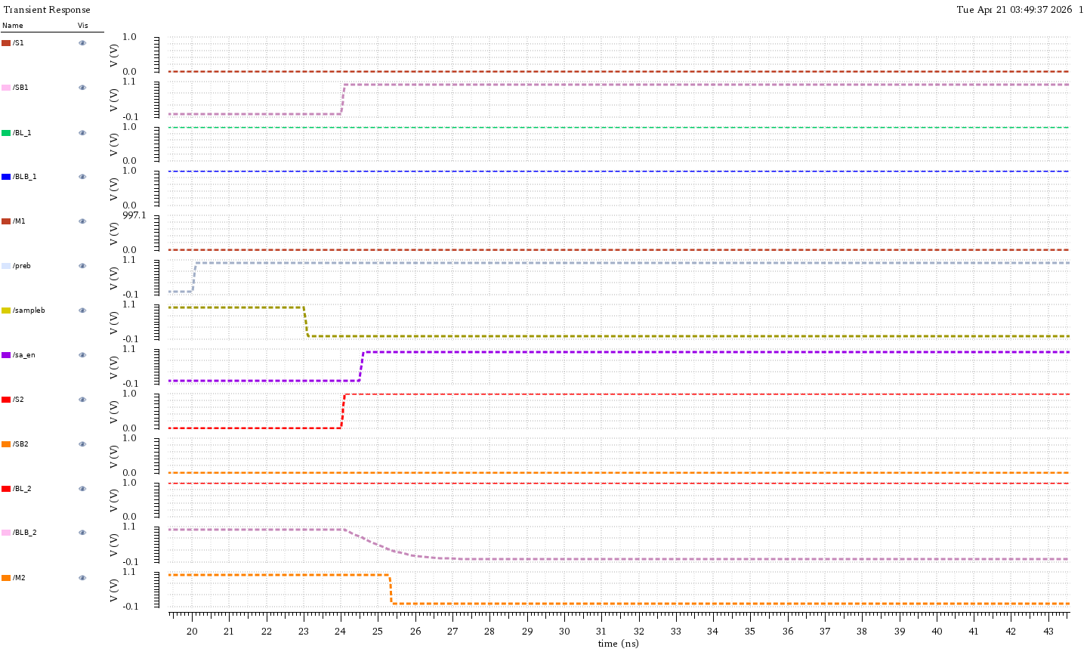
Proposed Memory Array: Search Operation
Start searching operation
Matched
S1 = 0
1
0
S2 = 1
0
1
Start searching operation
1
fgdfaa
1
Mistmatched
1
Time(ns)
Adapted from Jeloka et al., IEEE JSSC, 2016

Slide 8
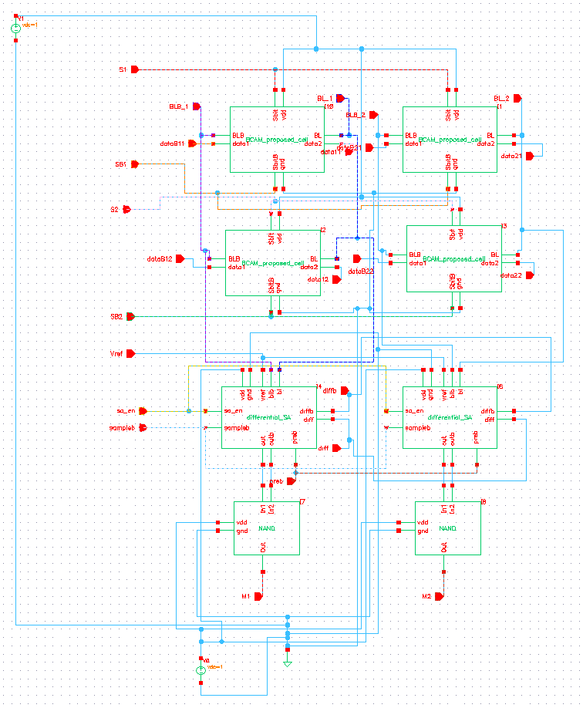
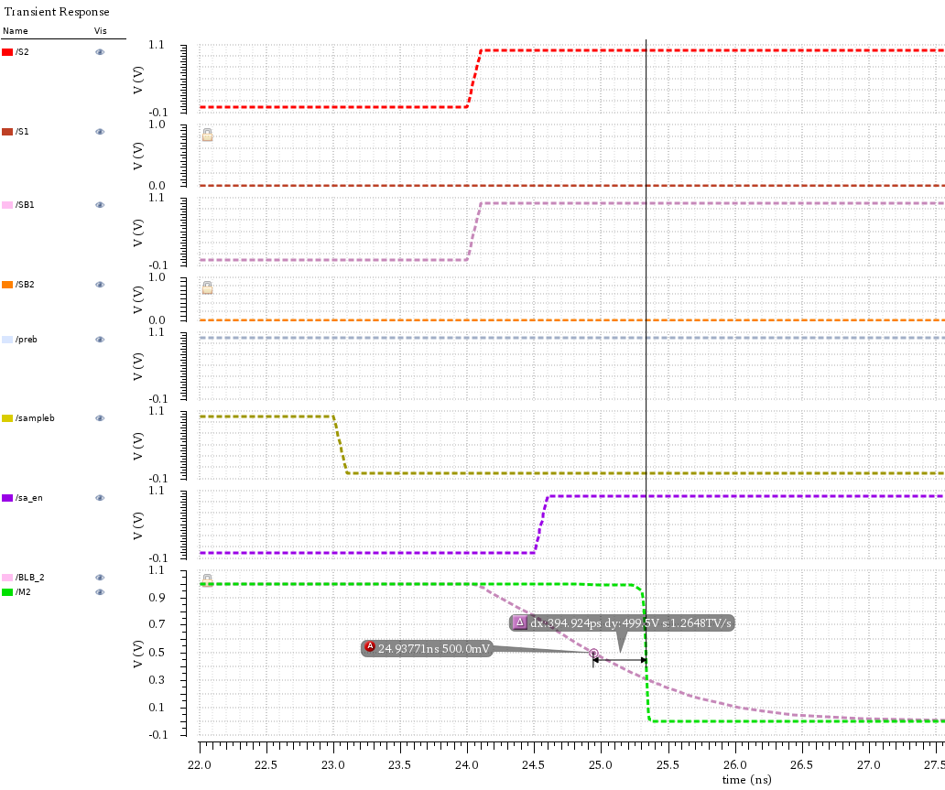
580.65mV

Slide 9
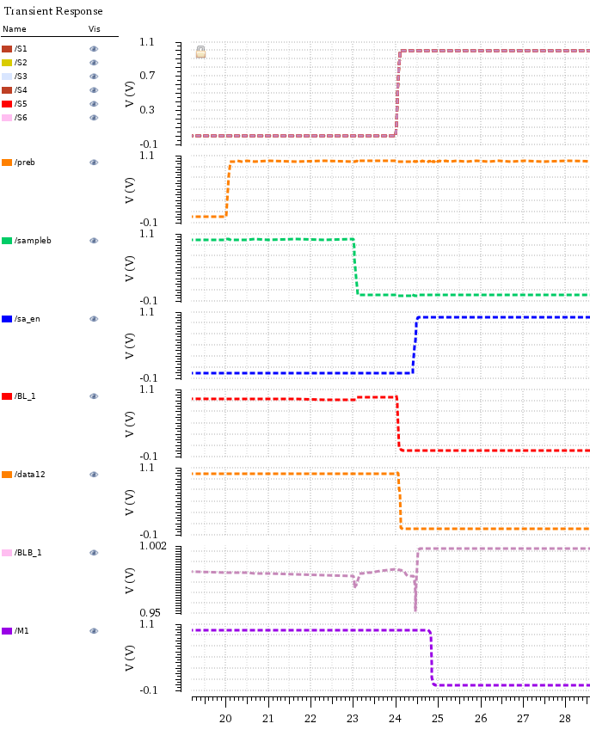
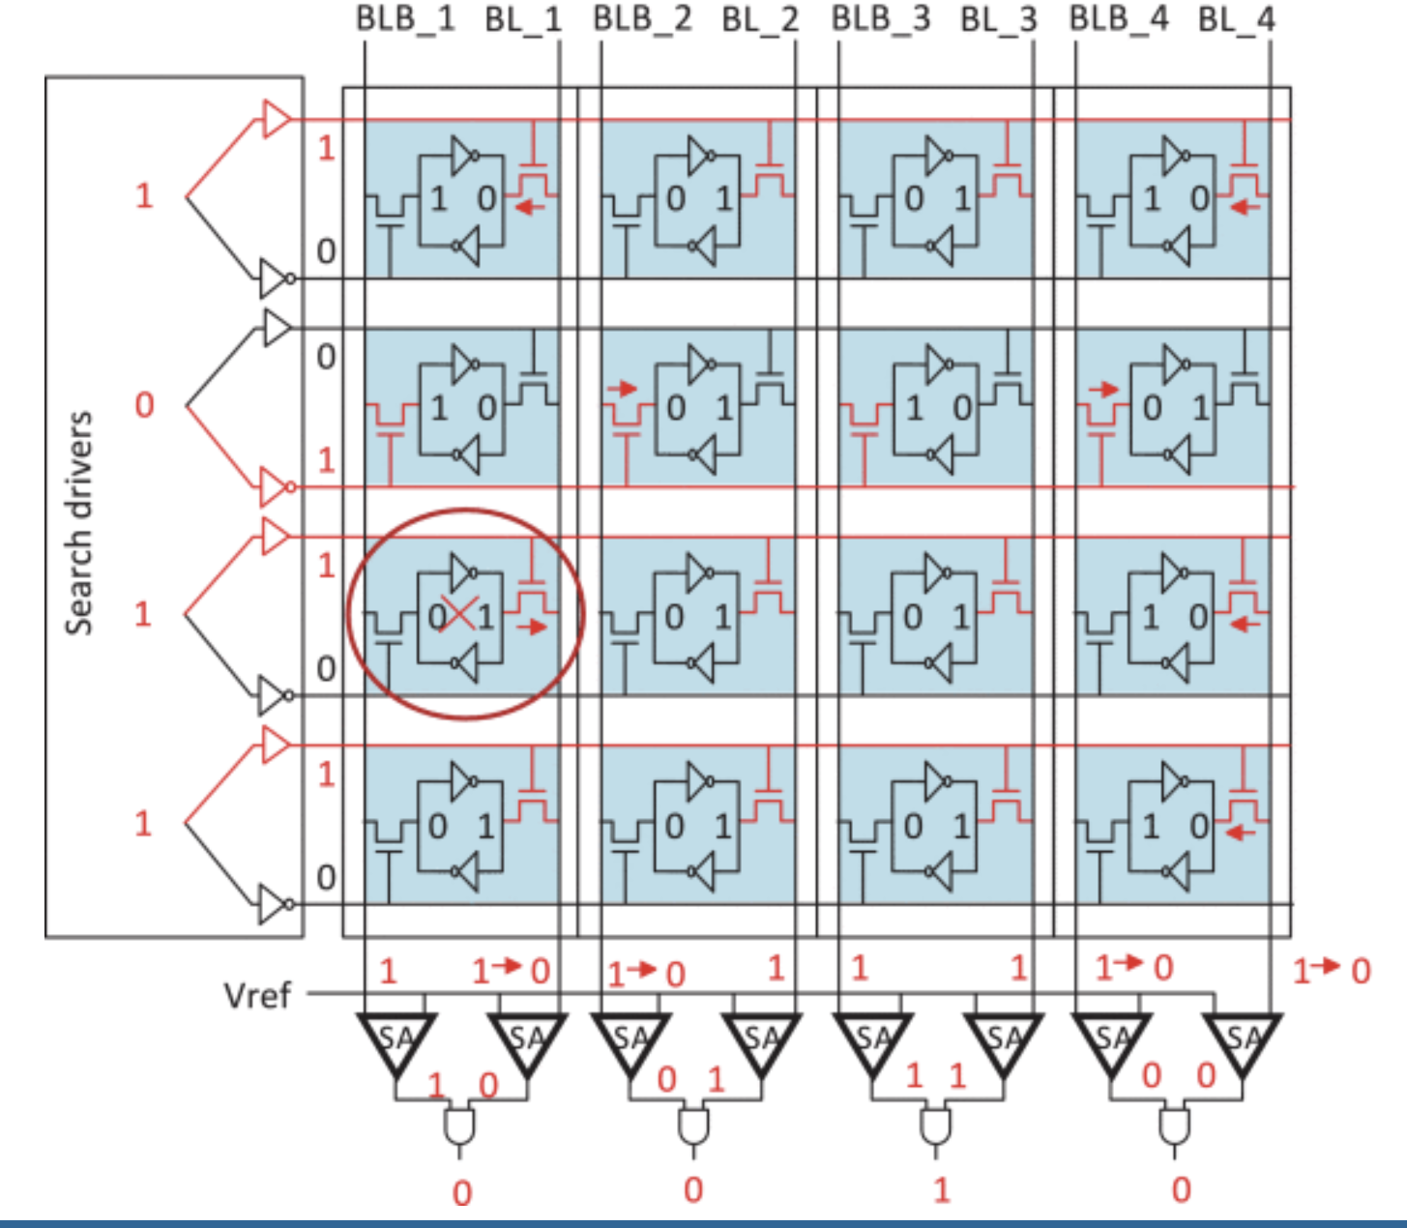
Proposed Memory Array: Search Problem
Start searching operation
Match/Mistmatch period
Data Overwritten
1->0
Adapted and Modified from Jeloka et al., IEEE JSSC, 2016
time(ns)

Slide 10
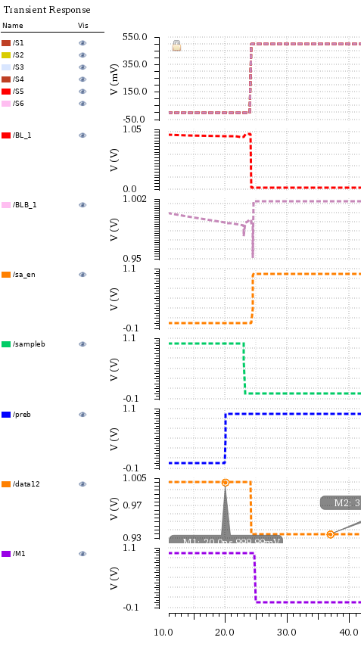
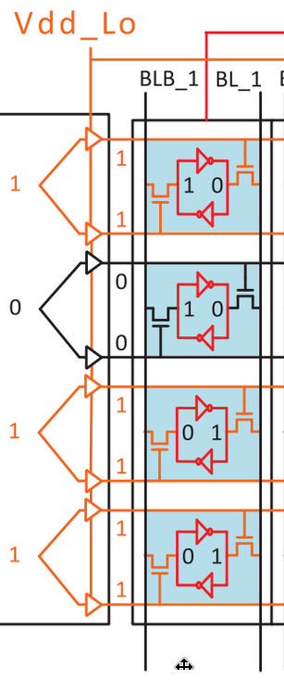
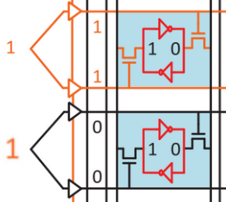
Proposed Memory Array: Search’s Solution
Vdd_Lo = 0.5V
Vdd_H = 1V
time(ns)

Slide 11
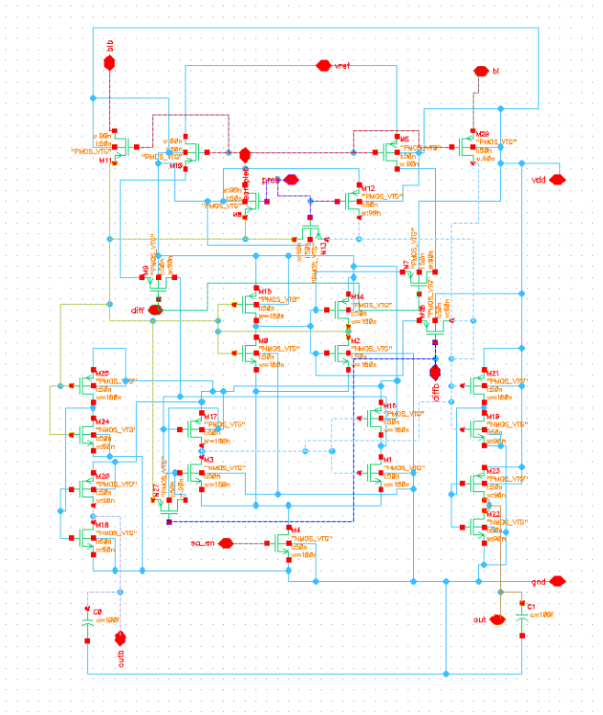
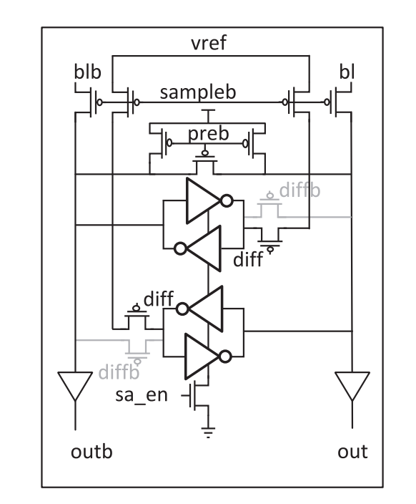
Proposed Configurable Sense Amplifier
Adapted from Jeloka et al., IEEE JSSC, 2016
Notes:
This maybe we can use our schematics

Slide 12
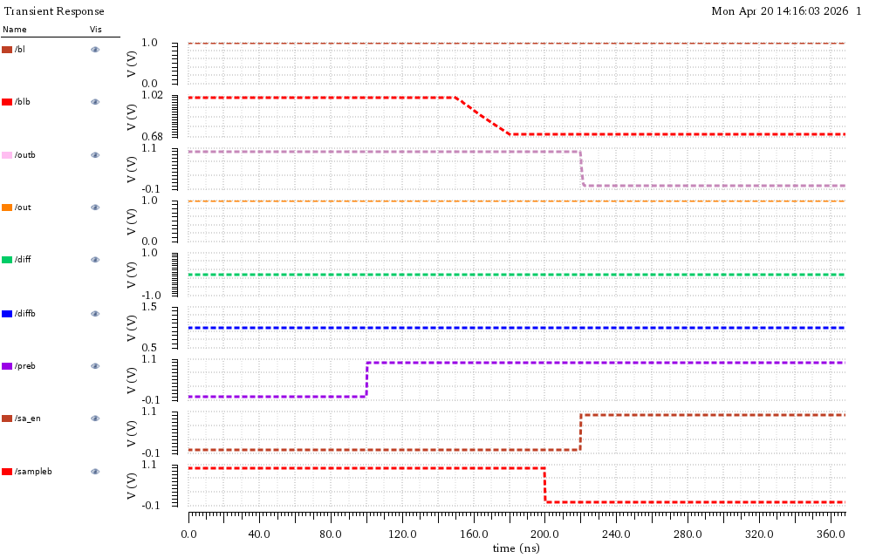
Configurable SA: CAM mode
sample
precharge
Amplifier turn on
Input (bitline) change
Vref = 0.8V

Slide 13
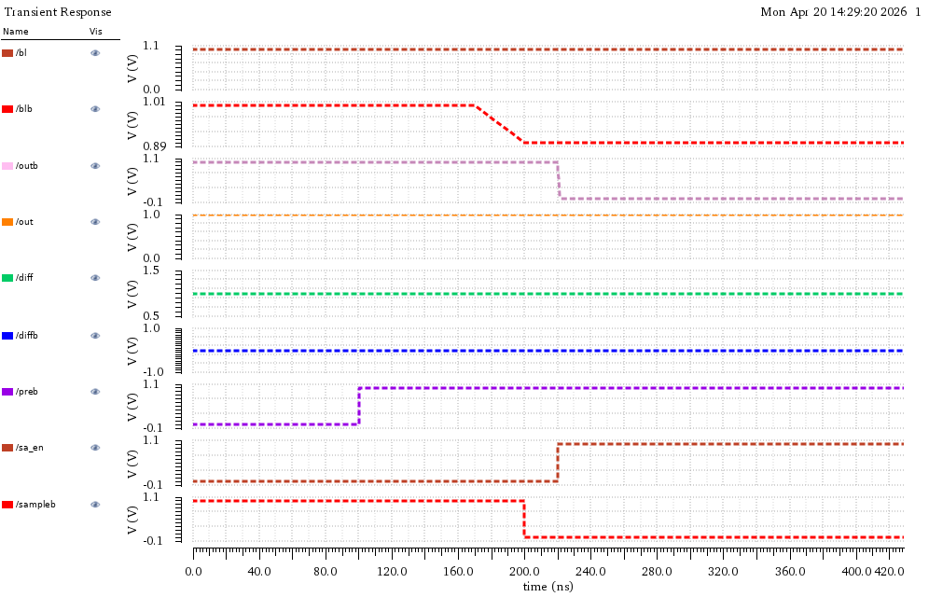
Configurable SA: SRAM mode
sample
Input (bitline) change
Amplifier turn on
precharge

Slide 14
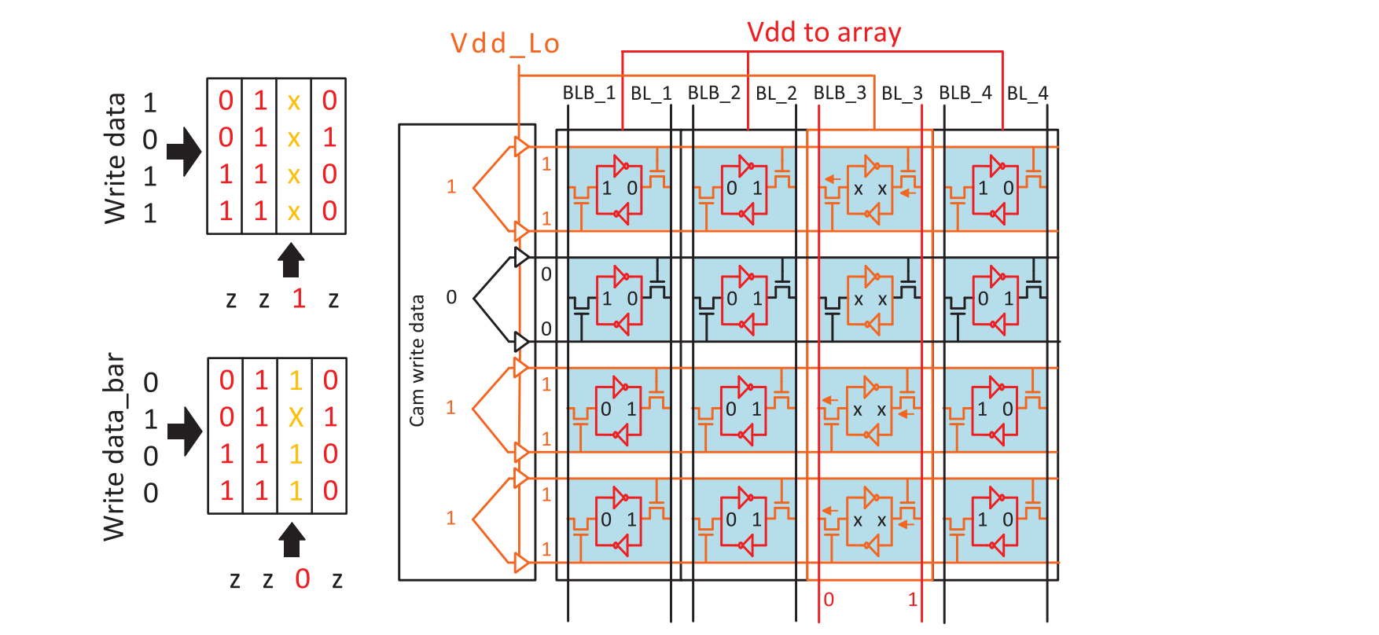
Proposed Memory Array: Write Operation
Adapted from Jeloka et al., IEEE JSSC, 2016

Slide 15
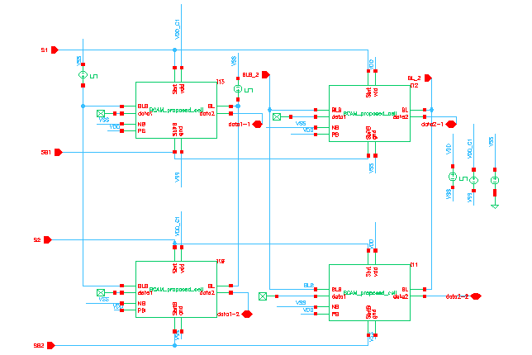
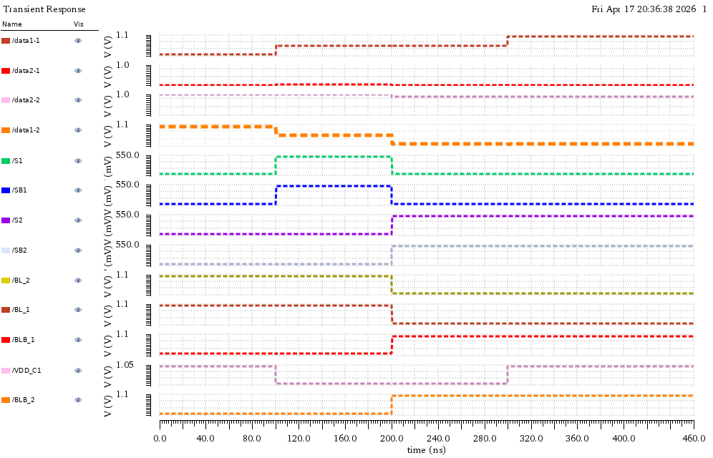
Proposed Memory Array: Write Operation
Write:
VDD = 0.5V
No write:
VDD = 1V
Before write
write 1
write 0
after write

Slide 16
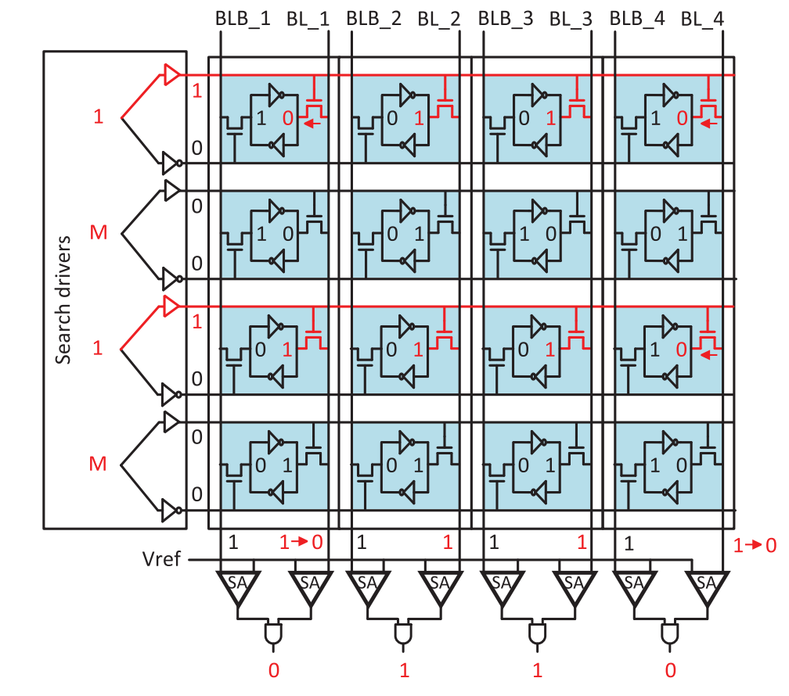
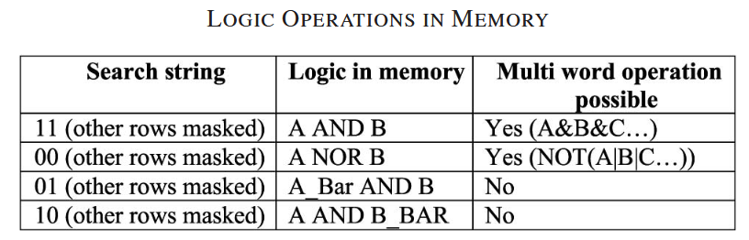
Proposed Array: SRAM Mode with Logic in Memory
Adapted from Jeloka et al., IEEE JSSC, 2016
Bitwise AND Operation

Slide 17
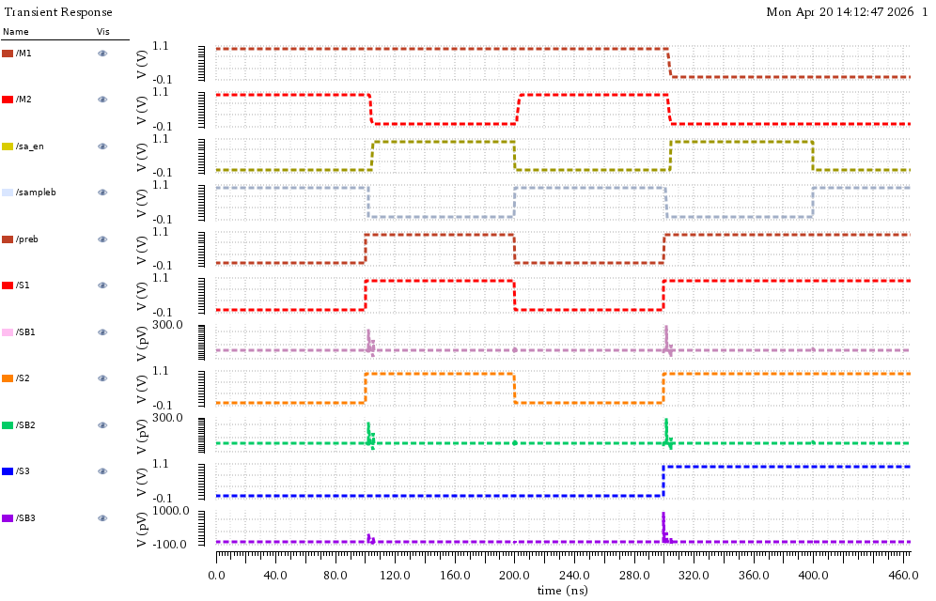
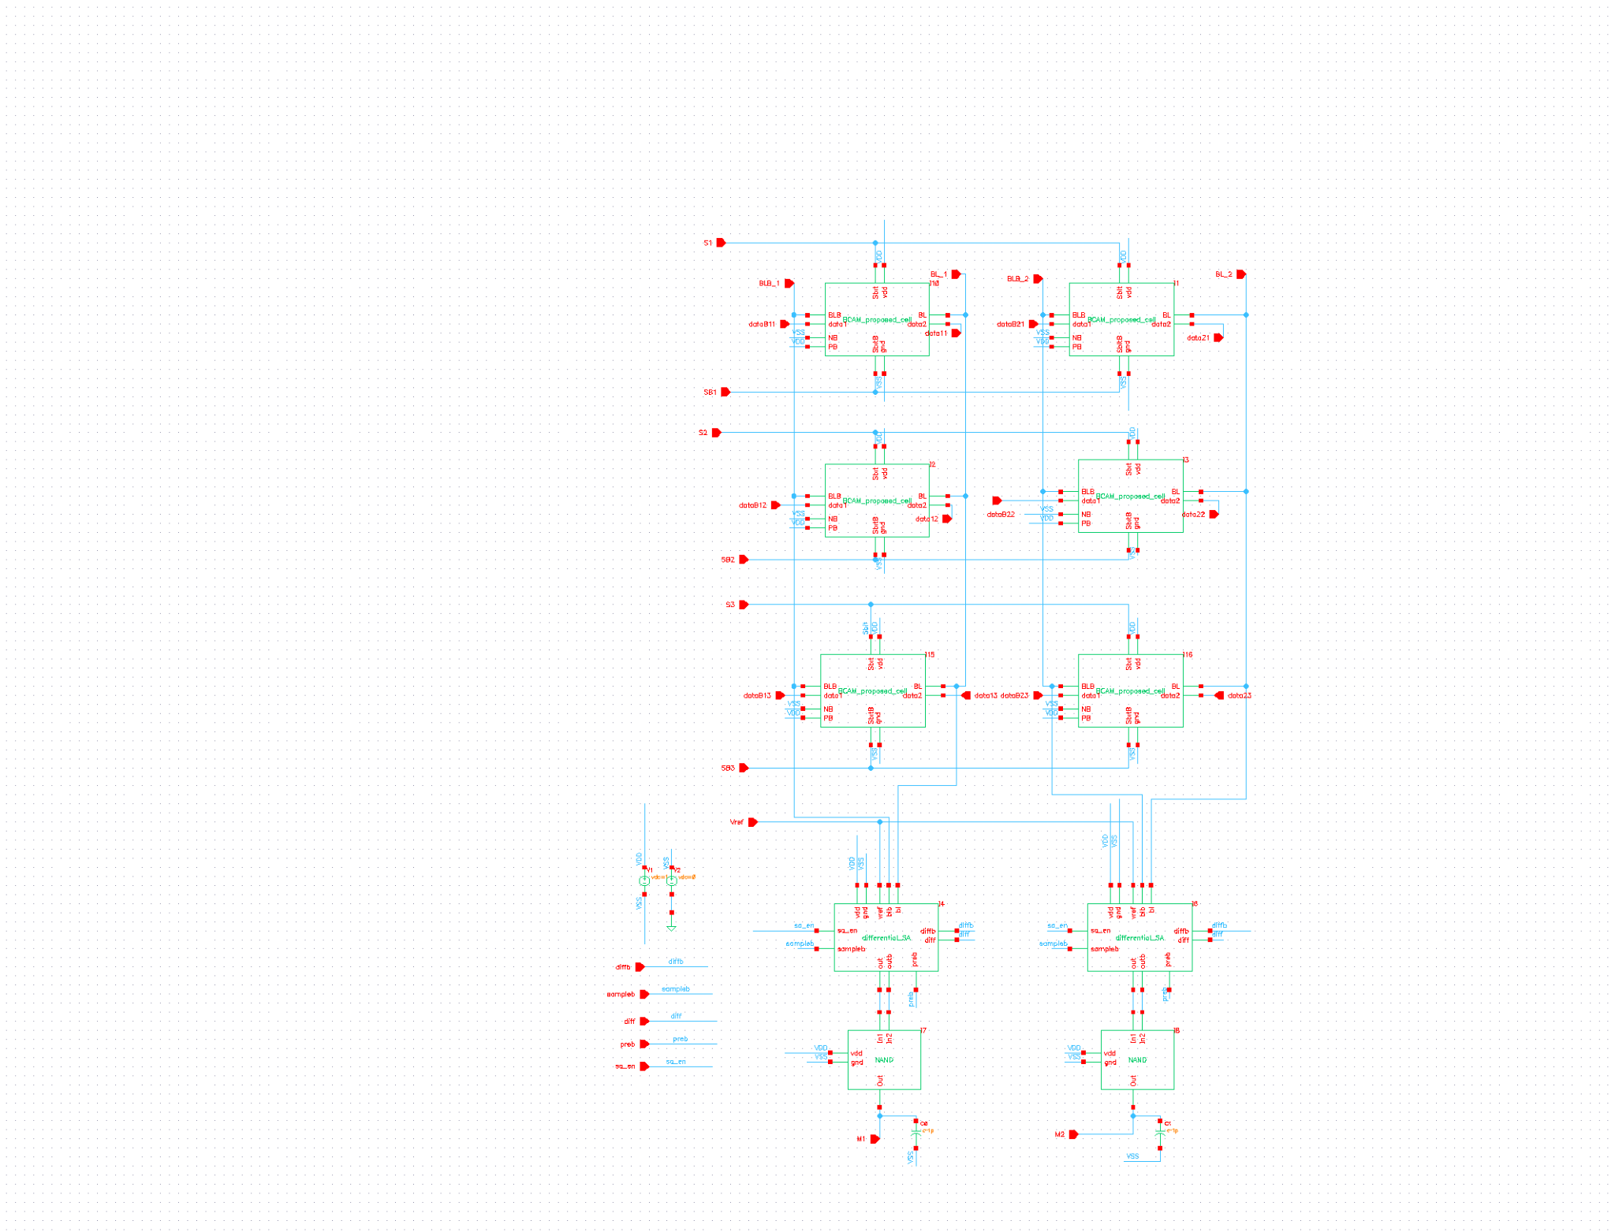
Proposed Array: SRAM Mode with Logic in Memory
Row 1 & Row 2
Row 1 & Row 2 & Row 3
Row 1 & Row 2
1
0
1
0
0
1

Slide 18
Comparison - area
10T BCAM
10T BCAM
10T
6T
Notes:
Smaller area and lower power without performance degradation

Slide 19
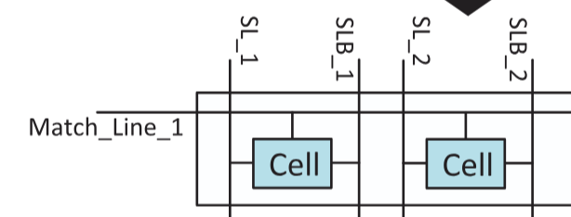
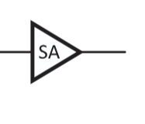
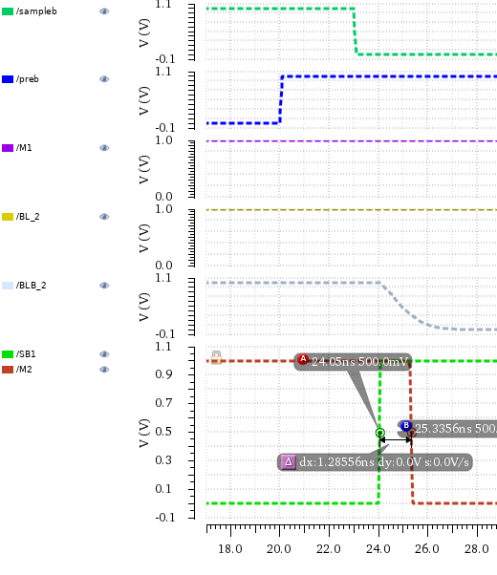
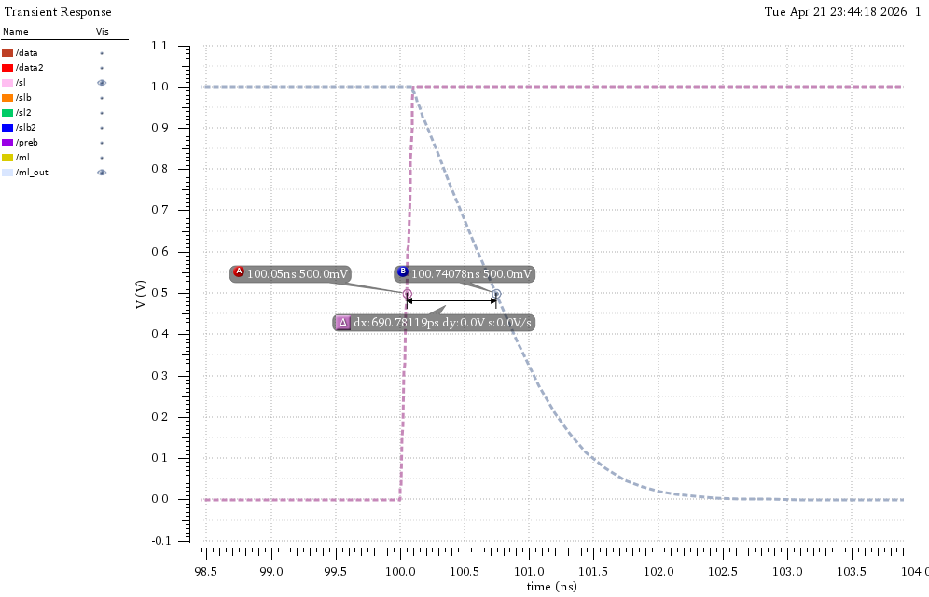
Comparison - latency
1.Conventional search
2.Configurable search
S1 = 0
match
mismatch
0
S2 = 1
1
1->0
1
fgdfaa
1
Load = 100fF
Delay = 690 ps
Delay = 1.28ns
Notes:
Smaller area and lower power without performance degradation. YEN AND YIXUAN BEFORE SA Around 884ps

Slide 20
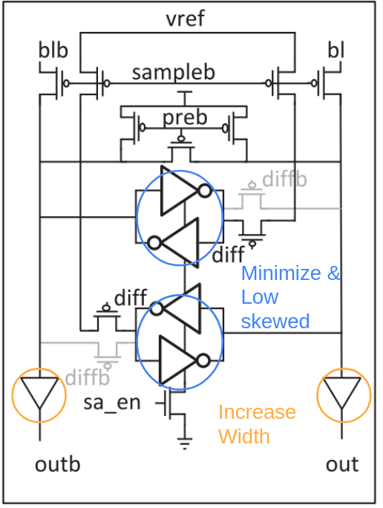
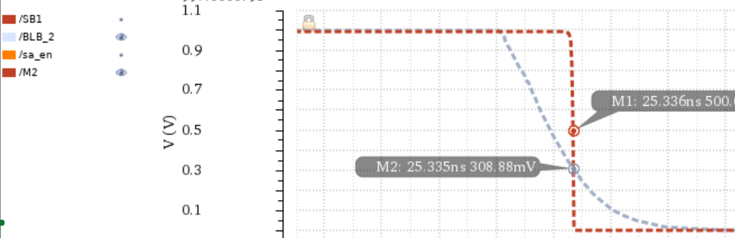
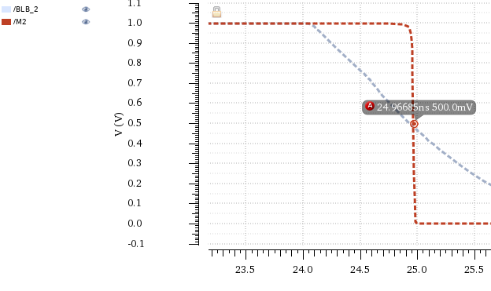
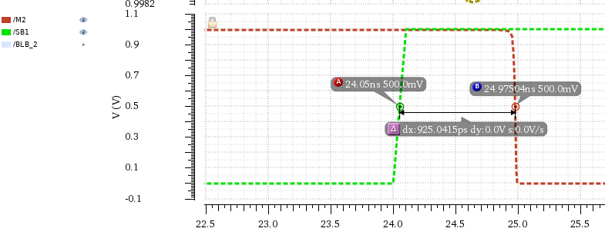
Before resize buffer
After resize buffer

Slide 21
Future Direction
Quantitative power comparison
TCAM configuration with the same structure

Slide 22
References
[1] S. Jeloka, N. B. Akesh, D. Sylvester and D. Blaauw, "A 28 nm Configurable Memory (TCAM/BCAM/SRAM) Using Push-Rule 6T Bit Cell Enabling Logic-in-Memory," in IEEE Journal of Solid-State Circuits, vol. 51, no. 4, pp. 1009-1021, April 2016, doi: 10.1109/JSSC.2016.2515510
[2] Journal of Electrical Systems Engineering and Scientific Research Groups (ESR Groups), “View of Design and Analysis Latch Sense Amplifier Used in SRAM IC by Using Low Power Techniques.” https://journal.esrgroups.org/jes/article/view/4626/3437
[3]M. K. Chaitanya and V. Ravi, “Design and Development of BIST Architecture for Characterization of S-RAM Stability,” Indian Journal of Science and Technology, vol. 9, no. 21, Jun. 2016, doi: https://doi.org/10.17485/ijst/2016/v9i21/89610.
‌
[4]Sajith Ahamed Palatham-Veedu “Design and Analysis of Sense Amplifier Circuits used in High Performance and Low-Power SRAMs”

